Slide 1
V2.4.0
New Features and Process

Slide 2
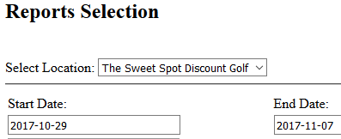
Reports
In this next installment we have added in a list of requested reports:
Tax Report
Cost of Goods Sold and Profit Margin Report
Items Sold Report
Discount Report
Top Selling Items Report
All Reports are run for the selected location and selected date range

Slide 3
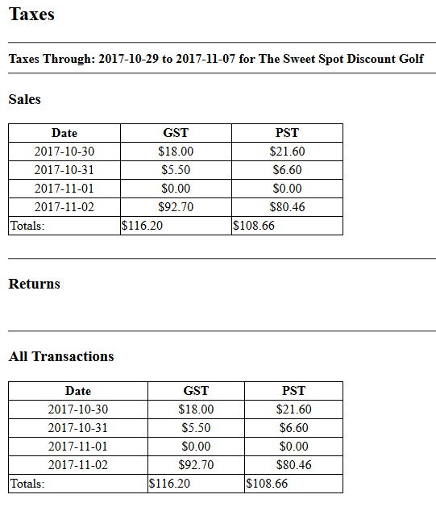
Tax Report
This report is broken down into three sections:
Sales
Returns
All Transactions
In each section is the total GST and PST charged from that location by date
Each section also show the charged over the selected time frame

Slide 4
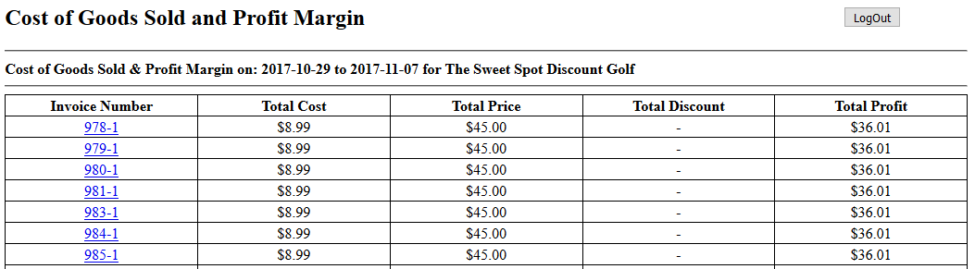
Cost of Goods Sold and Profit Margin Report
This report is broken down by invoice and displays:
Total Cost (Cost of all items sold on invoice)
Total Selling Price (Price of all items sold on invoice)
Discount (Dollar amount or percentage discount on invoice)
Total Profit (Price – Cost – Discount = Total Profit)

Slide 5
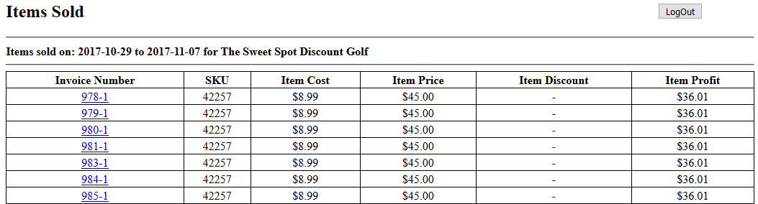
Items Sold Report
This report bears resemblance to the Cost of Goods Sold Report
The one difference is that the cost, price, discount, and profit are broken down by each item on an invoice

Slide 6
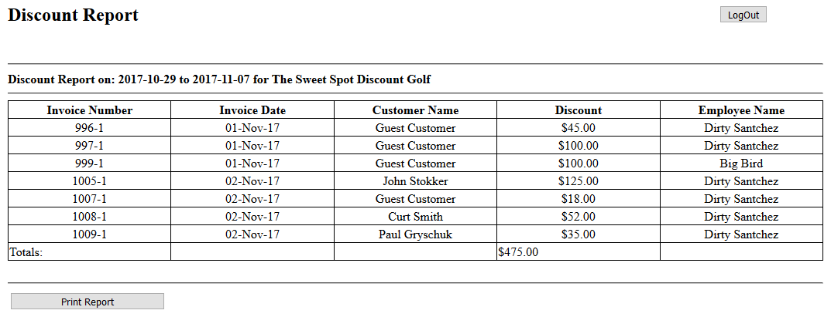
Discount Report
This report displays the total discount given on each invoice in the selected date range
Shows the customer that received the discount as well as the employee that gave the discount

Slide 7
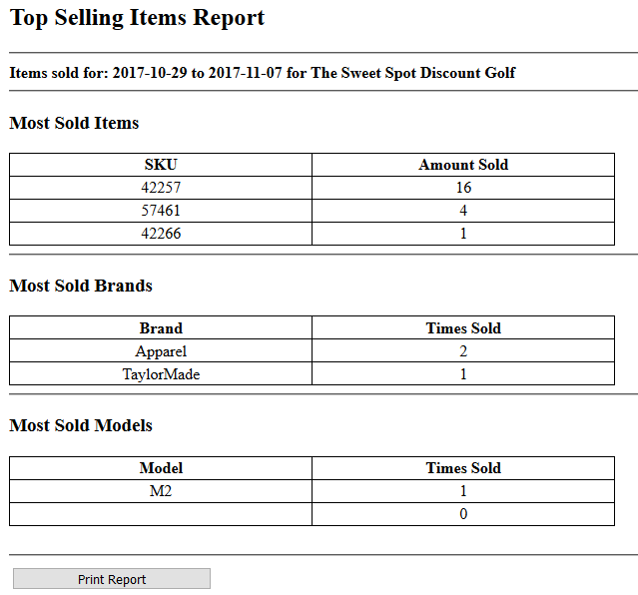
Top Selling Items Report
This report will give the user the info of the top 10 items sold in three categories:
SKU sold
Brand Type Sold
Model Type Sold

Slide 8
Bug Fixes
Error: When starting new sale items already in cart and cannot cancel sale or remove items from cart
Currently the only fix when this happens is to shut down the browser and re-open it
We believe that we have created a work around for the error so that it can’t happen anymore
If it does please report asap
Try to remember as much information about the previous sale as possible

Slide 9
Minor Updates/Changes
Now when making a purchase the user has the ability to change the customer from Guest to an existing customer or add them as a new customer
Printing invoices should now utilize more page space

